Slide 1
Spoken Language Recognition on Open-Source Datasets
Brady Arendale
Samira Zarandioon
Ryan Goodwin
Douglas Reynolds, Ph.D.

Slide 2
Background
Speaker and language recognition is a well-established field
Use cases include automatic speaker verification and automatic call routing
Typically uses private or expensive datasets
Little comparison between different techniques

Slide 3
Our problem
Identify a spoken language from audio data
Use free, public datasets
Compare several state-of-the-art models

Slide 4
Data collection
Few free multilingual datasets available
Manually downloaded data from Mozilla’s Common Voice and Google Bengali corpus from OpenSLR
Web scraped Audio Lingua (holdout test set)

Slide 5
Languages used
Eight languages: Bengali, Catalan, English, French, German, Kabyle, Persian, Spanish
~130 hours per language
Chosen based on amount of data available

Slide 6
Feature extraction
Split audio into two-second chunks at 8000 Hz
Extracted raw waveforms and filterbanks
Waveforms measure amplitude of sound wave over time

Slide 7
Feature extraction
Filterbanks (aka log mel spectrogram) measure frequencies that make up a sound wave over time
Fourier transform over short time frames (25 ms), scaled to approximate human hearing (Mel scale)

Slide 8
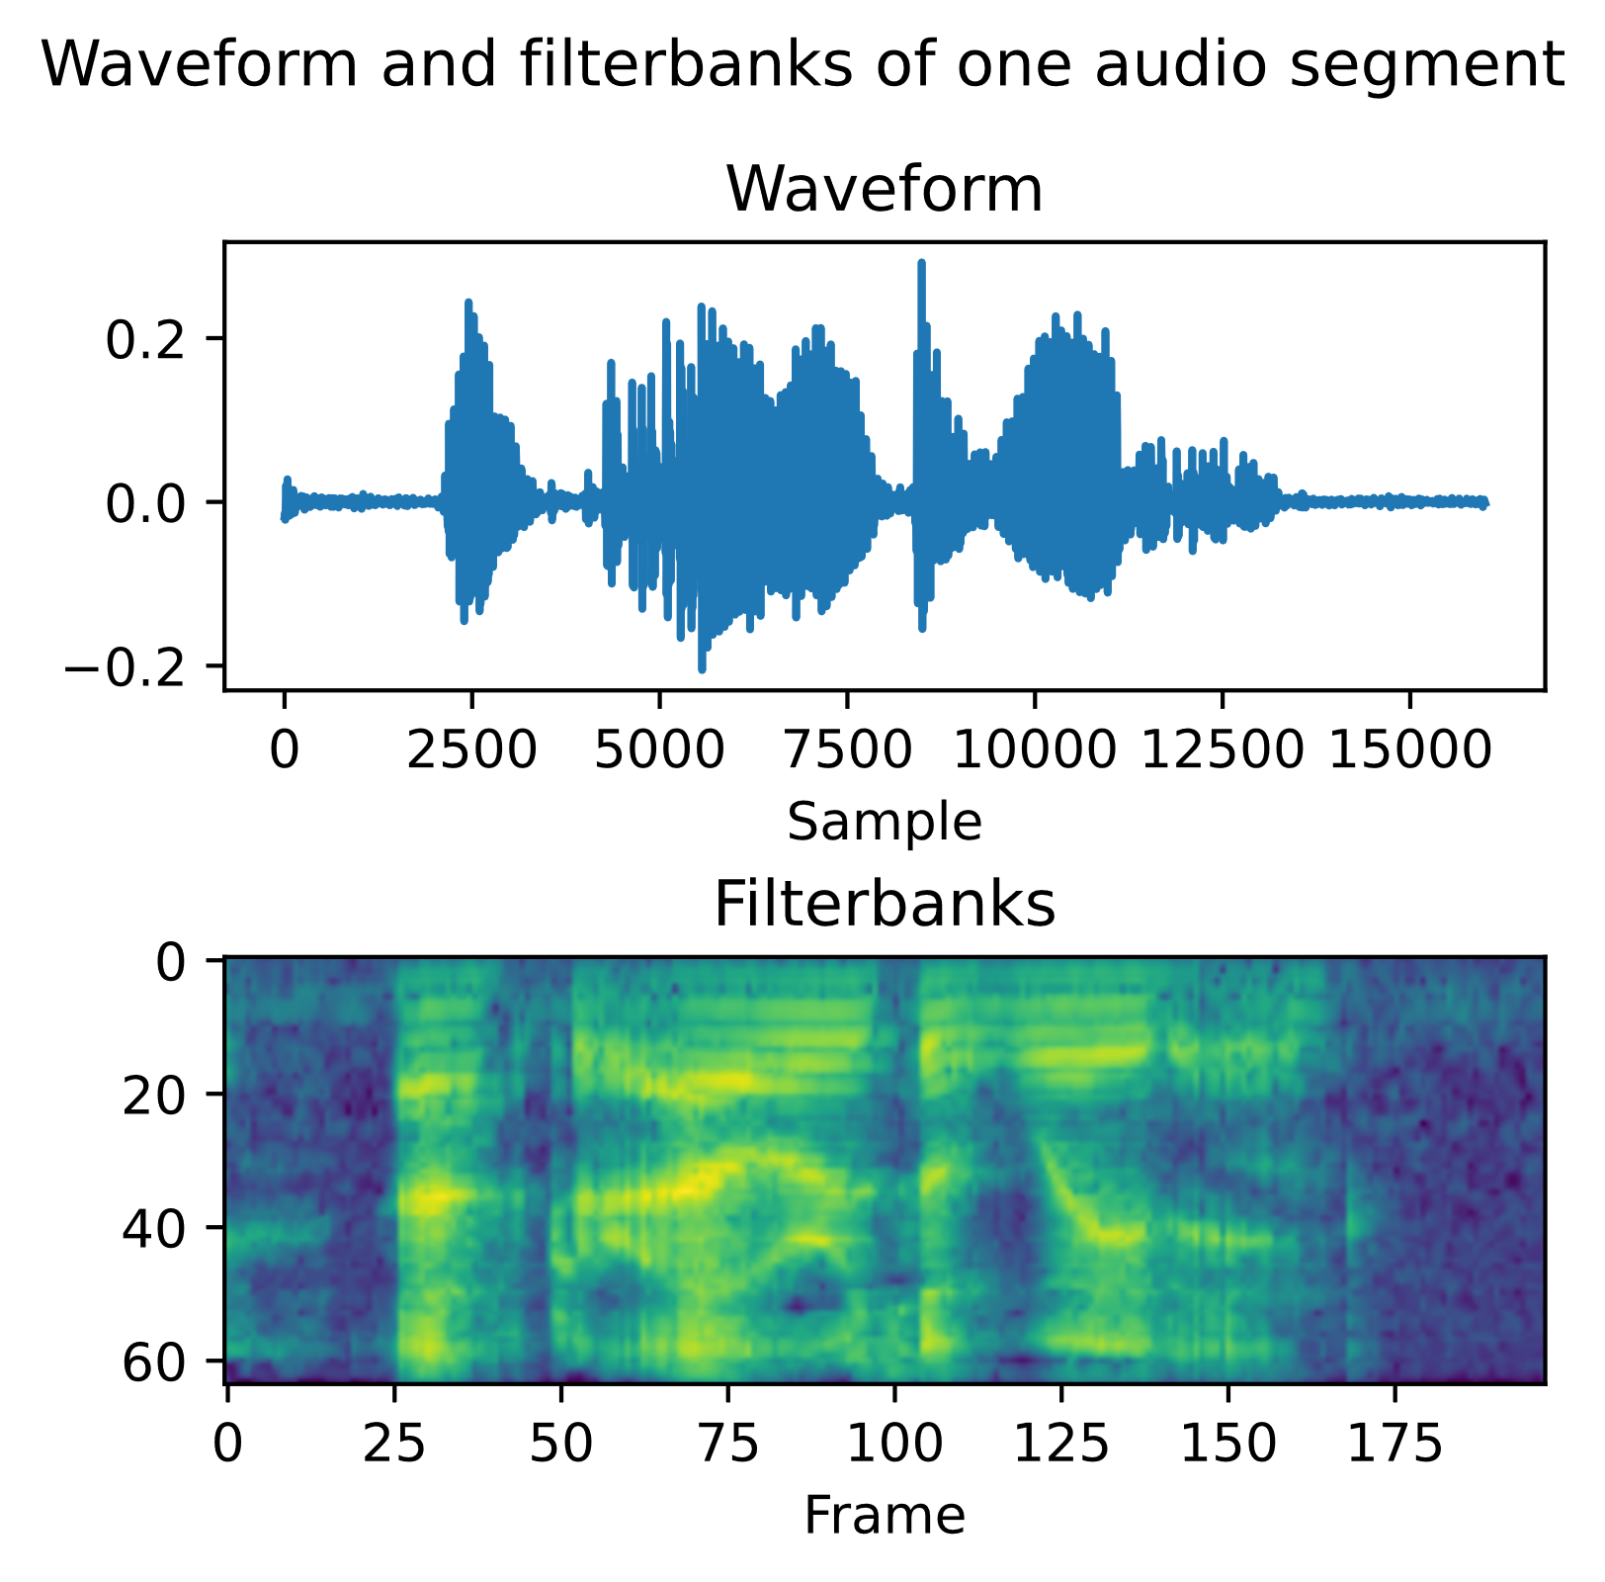
Waveforms vs. filterbanks
Waveforms: more complex data representation, harder to learn
Filterbanks: interpretable data at distinguishable time steps, easier to learn, slower to compute

Slide 9
Models trained
Three model architectures
E-TDNN: deep 1D convolutional neural network using filterbank features
M5: deep 1D CNN using waveform features
SincNet: CNN based, attemps to learn more meaningful filterbanks

Slide 10
E-TDNN (filterbanks)
Series of four convolutional-dense blocks with increasing context window
Mean and standard devation pooling
Three dense layers
CNN-Dense block context [t-2, t+2]
CNN-Dense block context {t-2, t, t+2}
CNN-Dense block context {t-3, t, t+3}
CNN-Dense block context {t-4, t, t+4}
Dense
(1536 neurons)
Mean & SD pooling
(output size 3072)
Dense
(512 neurons)
Dense
(512 neurons)
Dense-softmax
(8 neurons)

Slide 11
M5 (waveform)
Four convolutional-max pooling blocks with increasing filter size
Global average pooling
Two dense layers
CNN (80 filters, context 4) Max pooling (context 4)
CNN (128 filters, context 3) Max pooling (context 4)
CNN (256 filters, context 3) Max pooling (context 4)
CNN (512 filters, context 3) Max pooling (context 4)
Global average pooling
Dense
(100 neurons)
Dense-softmax
(8 neurons)

Slide 12
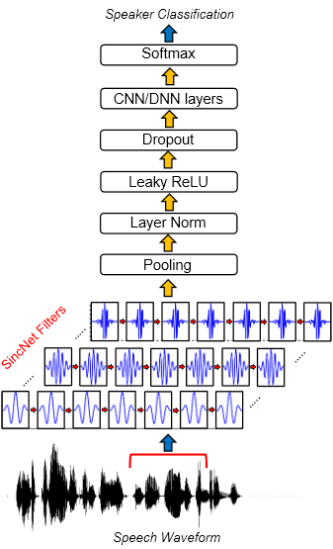
SincNet
Attempts to learn more meaningful filterbanks using bandpass filters
Compute 80 trainable filterbanks
Two CNN layers
Four dense layers
Source: “Speaker Recognition from Raw Waveform with SincNet”, Ravanelli and Bengio (2019)

Slide 13
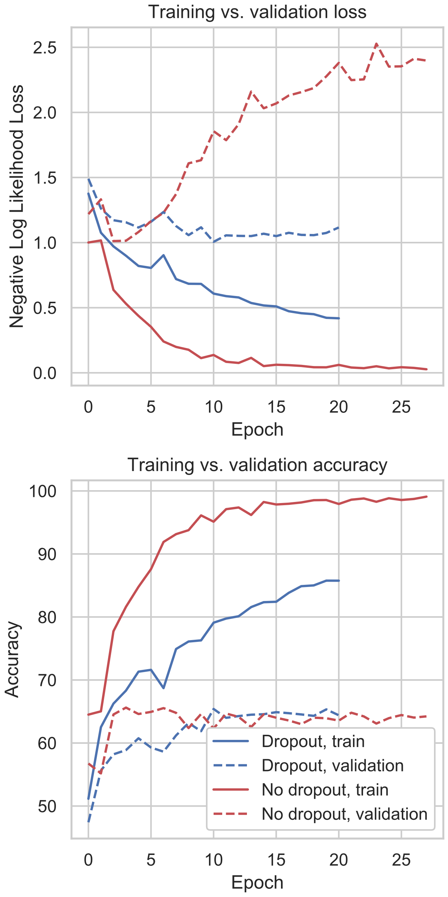
SincNet
Massively overfit with default parameters
Added 50% dropout in dense layers
Reduced overfitting, but no improvement in validation accuracy

Slide 14
Results
Model | Test accuracy (8 languages) | Training time per epoch
E-TDNN | 90.5% | 1.5 hours
M5 | 77.5% | 11 minutes
SincNet (w/ dropout) | 63.0% | 40 minutes
SincNet (no dropout) | 62.1% | 40 minutes

Slide 15
Audio Lingua test results
Model | Audio Lingua test accuracy | CV/Bengali test accuracy (5 languages) | Delta
E-TDNN | 74.8% | 88.8% | -14.0%
M5 | 49.7% | 73.6% | -23.8%
SincNet (w/ dropout) | 35.5% | 57.8% | -22.4%
SincNet (no dropout) | 31.5% | 53.9% | -22.3%

Slide 16
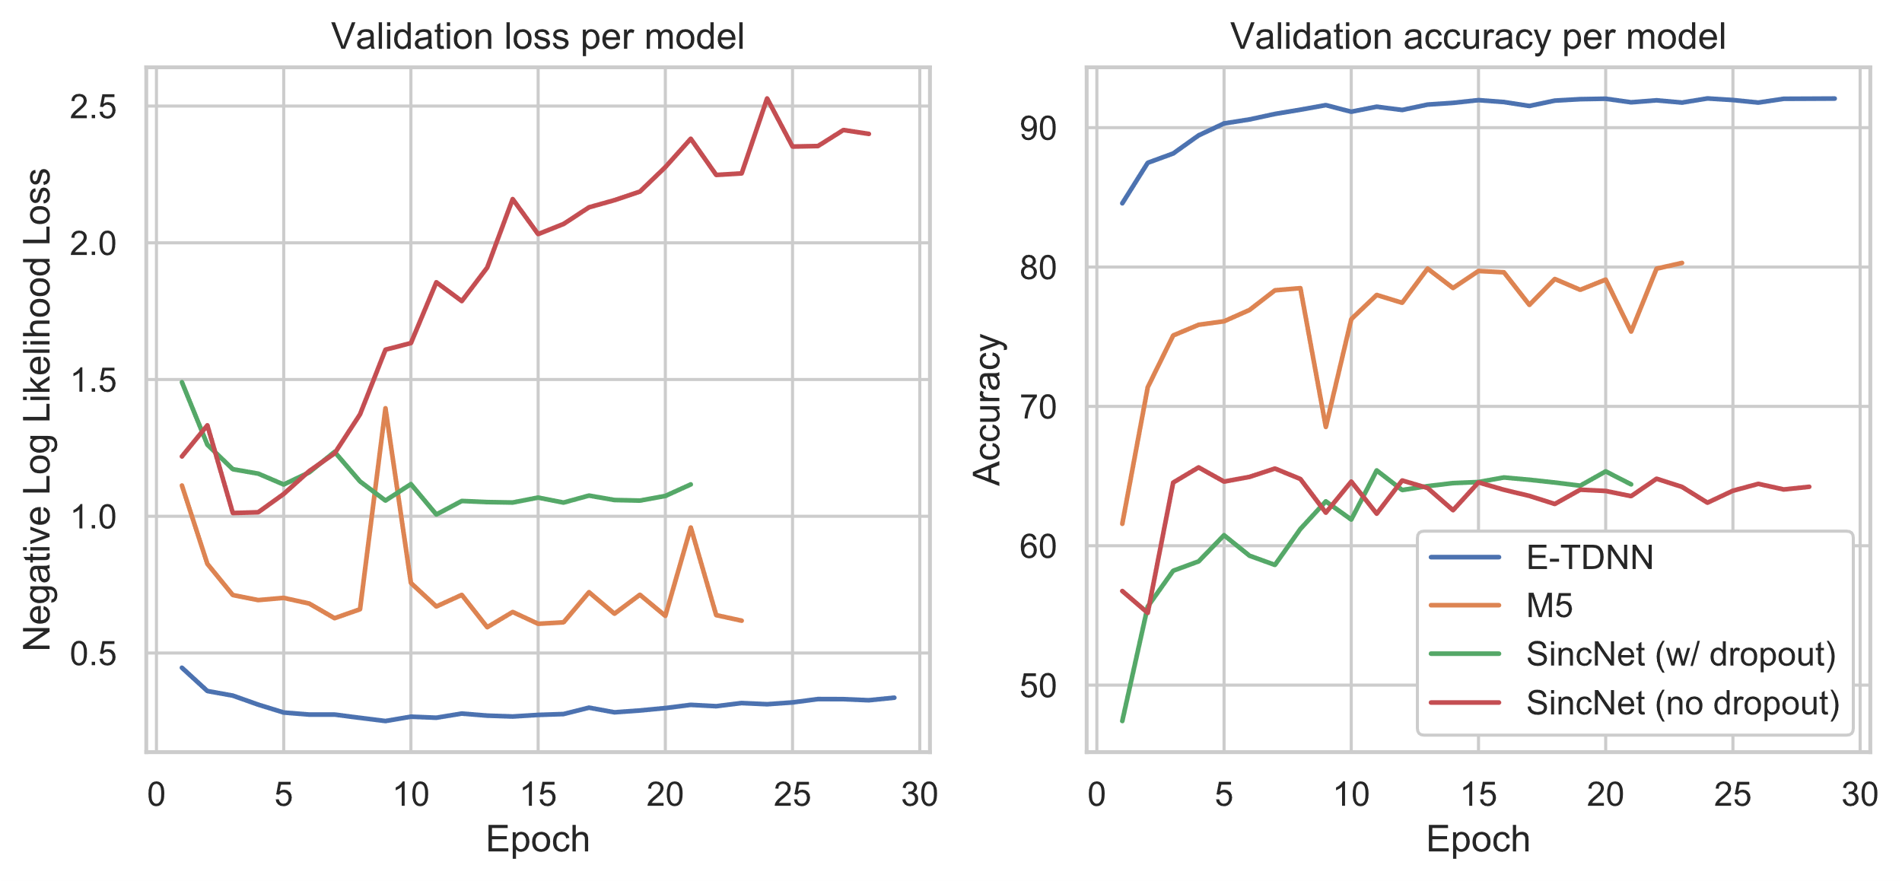
Training curves

Slide 17
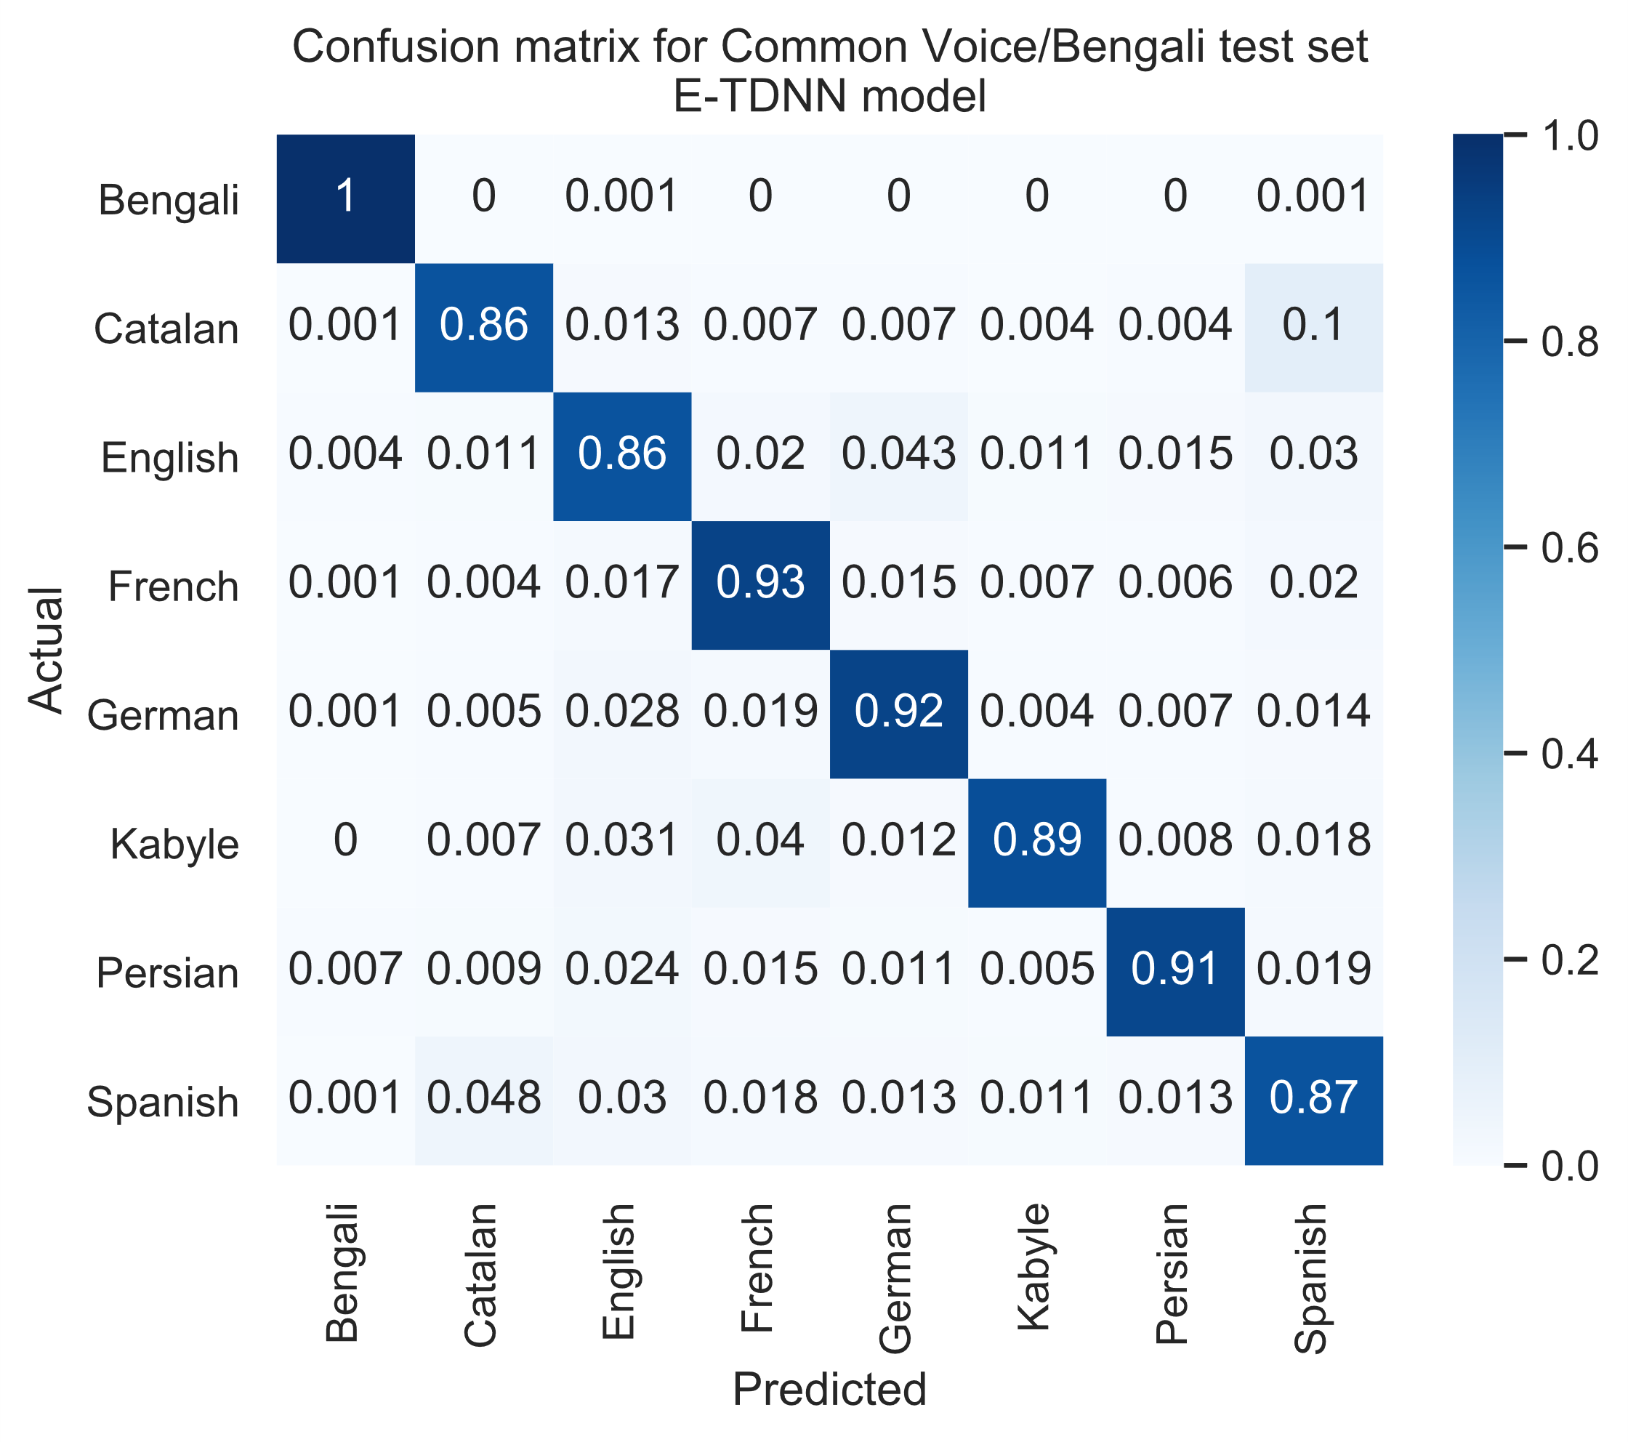
Confusion matrix: E-TDNN

Slide 18
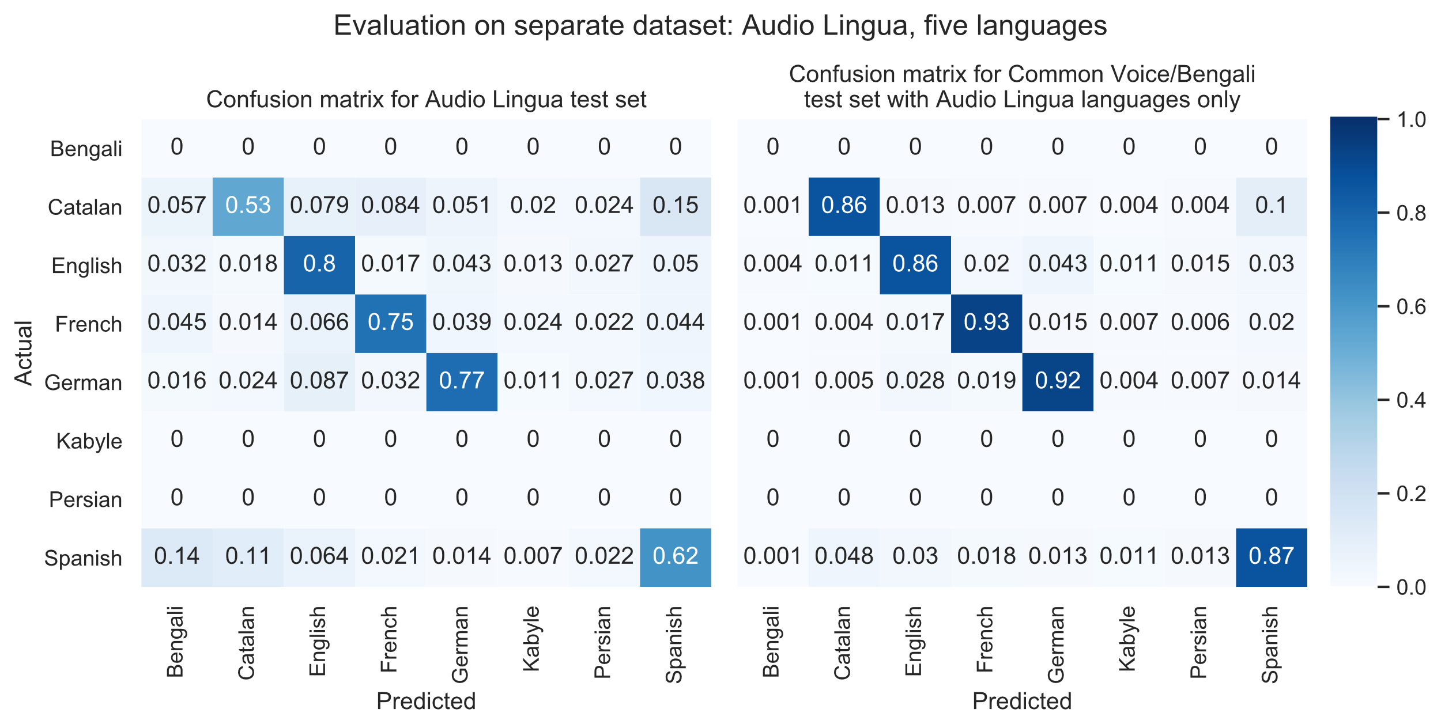
Audio Lingua test set confusion matrix: E-TDNN

Slide 19
Results
E-TDNN performed the best of all models on test accuracy for both test sets
E-TDNN had the best generalization
M5 performed the best of the waveform models and trained fastest

Slide 20
Challenges faced
High memory, storage, and computation requirements
Few data sources available
Research requires steep learning curve

Slide 21
Conclusion
Models designed using private datasets also perform well on public datasets
Generalization to other datasets is a problem
More datasets, data augmentation

